Slide 1
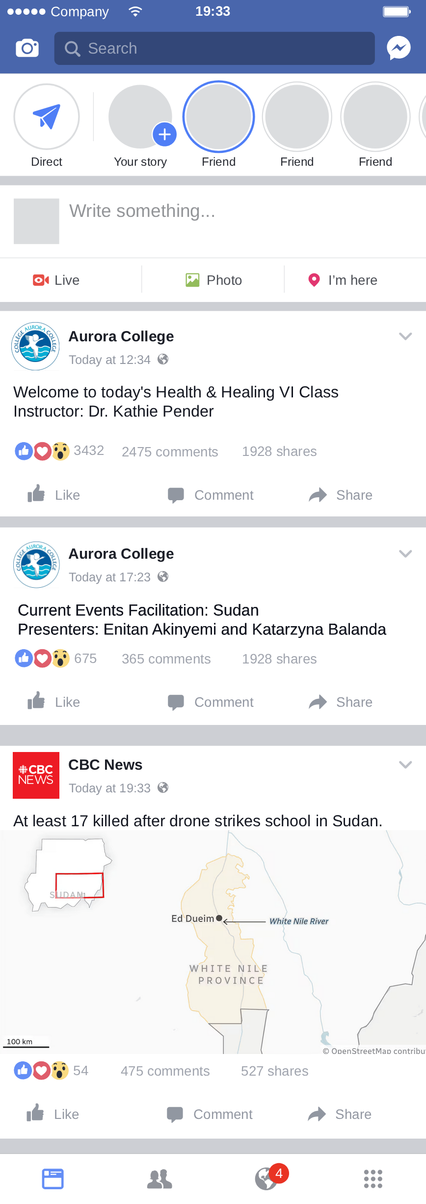
https://marinad.com.ar/free-
facebook-mobile-layout-feed-
profile/

Slide 2

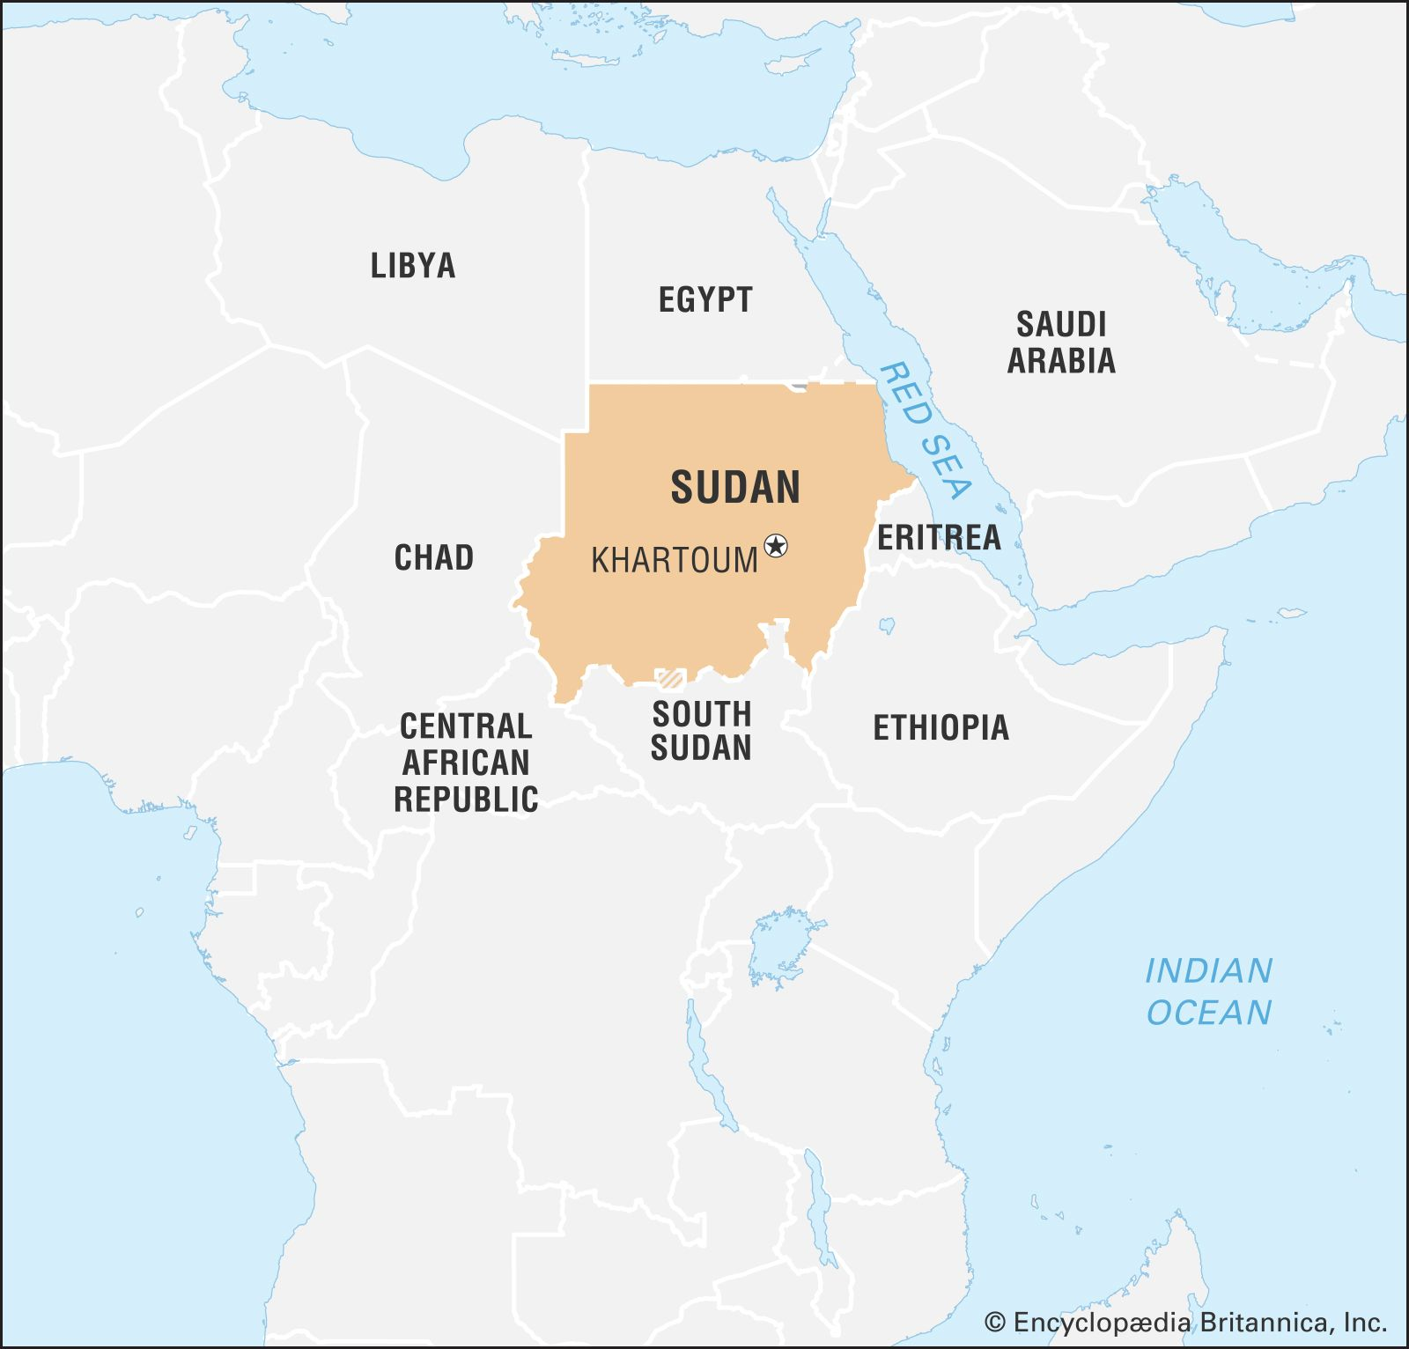

Sudan
Northeast Africa: third largest country on the continent
Capital: Khartoum
Population: ~48-52 million (UN, 2025)
Majority Sunni Muslim but with significant ethnic and regional diversity
18 States (key regions: Darfur (west), Kordofan (centre), White Nile (south)
South Sudan is a separate country: Independent in 2011
https://cdn.britannica.com/63/183763-050-D238B196/World-Data-Locator-Map-Sudan.jpg
https://www.abflags.com/_flags/flags-of-the-world/Sudan%20flag/Sudan%20flag-XXL-anim.gif

Slide 3




The Sudanese Civil War (2023-current)
April 2019
Long time president Omar al-Bashir (in office since 1993) removed from office after nationwide protests.
October/November 2021
Sudanese coup d'état, Sudanese armed forces and Rapid Support Forces take control of the government.
April 15, 2023
War erupts in Khartoum
SUDANESE ARMED FORCES
RAPID SUPPORT FORCE

Slide 4
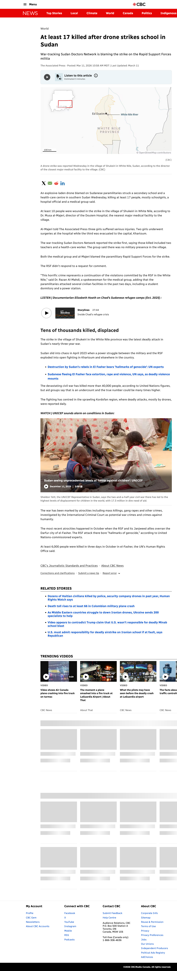
The Article
March 11, 2026
Shukeiri, White Nile, Sudan
17 Killed. Mostly schoolchildren
No military presence.
This was a targeted attack.
https://www.cbc.ca/news/world/sudan-white-nile-school-strike-rsf-blamed-9.7124191

Slide 5

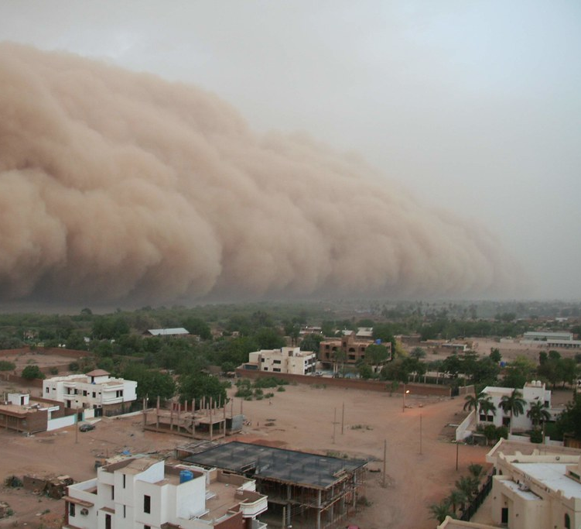
Who are the RSF?
Rapid Support Forces (RSF)
Sudanese paramilitary group
Formerly the Janjaweed
History of genocidal actions
201 verified attacks on healthcare since April 2023 (World Health Organization, 2026, January 9)
https://twistedsifter.com/2013/01/photos-of-haboobs-dust-storms/

Slide 6
Civilians as a Target
Health Centre struck
Student dormitory attacked
Power station attacked
School struck
“An attack on a hospital is not only an attack on a building, it’s an attack on people seeking care, on health workers risking their lives to save others, and on the very possibility of survival at times of crisis”
- Dr Hala Khudari, WHO Deputy Representative to Sudan

Slide 7

Why This Matters: The Scale
Sudan: WHO Eastern Mediterranean Region (EMRO)
4th deadliest conflict in the world: up to 150,000 killed
33.7 million people need humanitarian assistance: two thirds of the population
19.2 million at risk due to severely limited access to food
World's largest displacement crisis: 4.3 million refugees into Chad, Egypt, South Sudan
https://www.psforum.org/wp-content/uploads/2024/05/depositphotos_645551556-stock-photo-sudan-waving-flag-beautiful-sky.webp

Slide 8
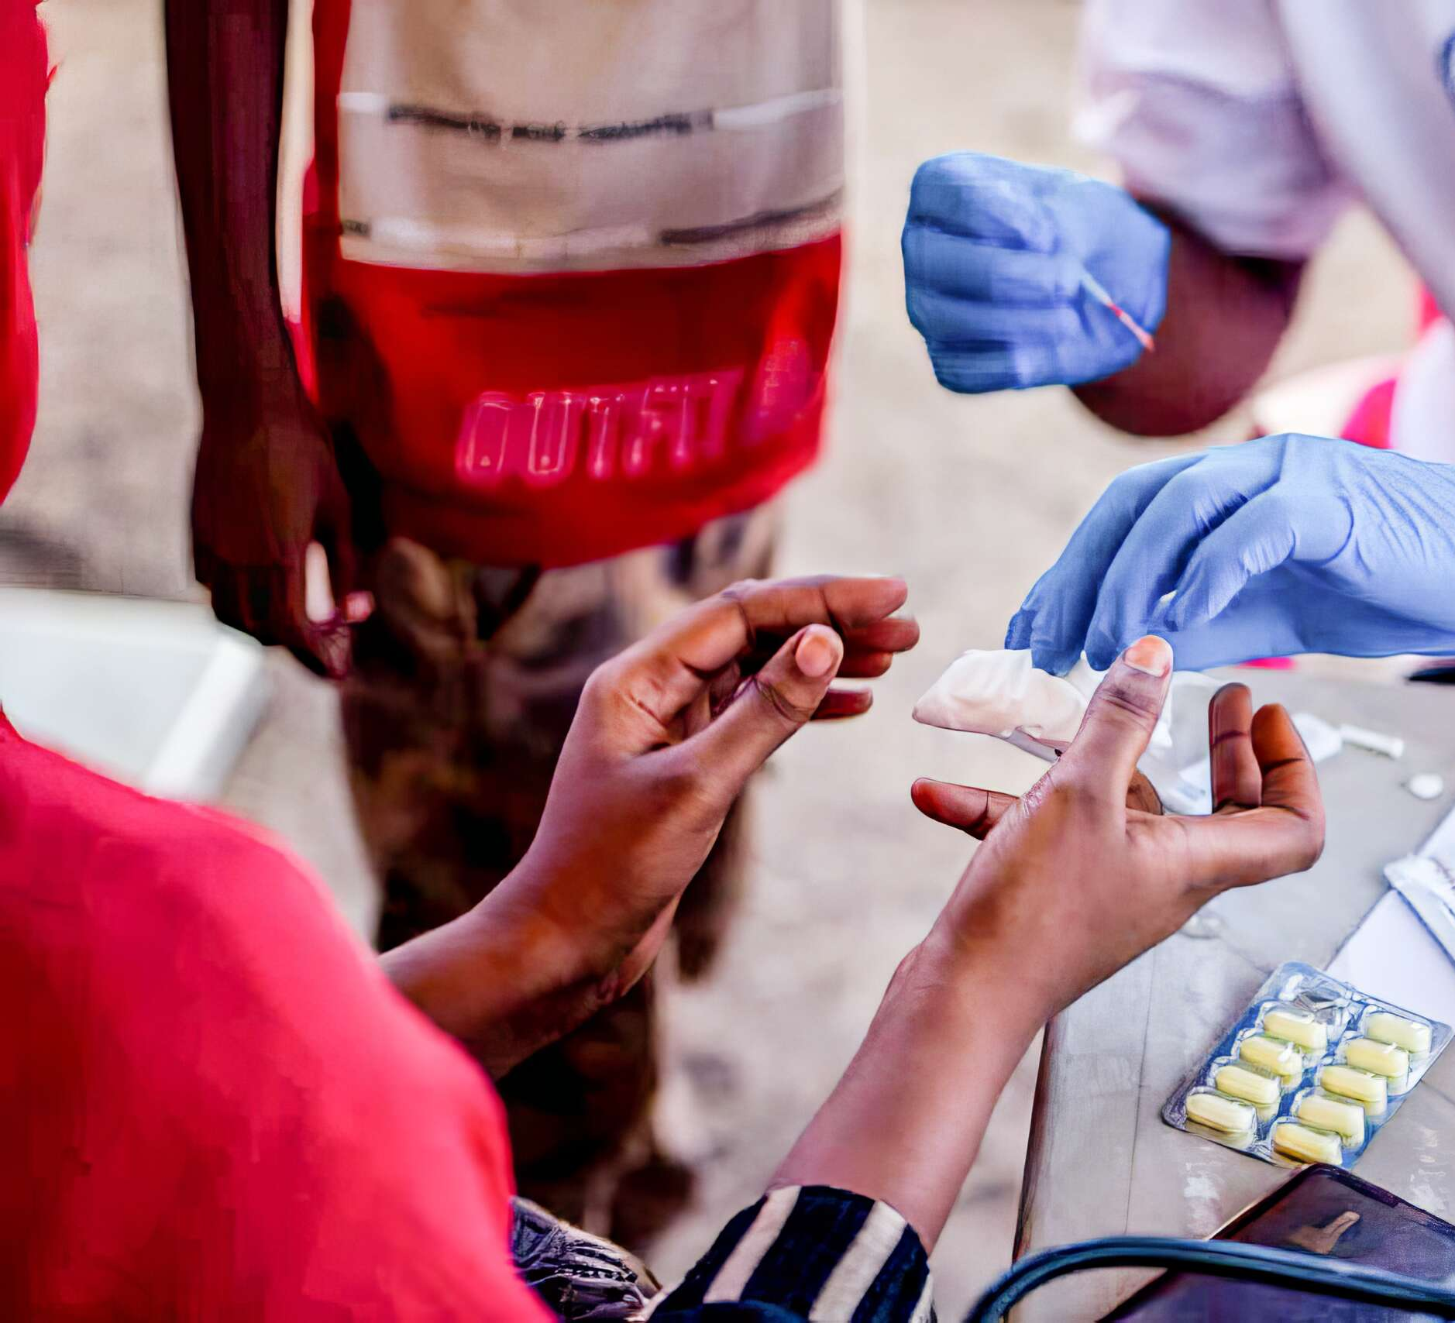
Impact on Global Health
All 18 states: simultaneous outbreaks of cholera, malaria, dengue, measles
120,000 cholera cases; over 3,000 deaths
80% of hospitals non-functional in conflict areas
2 in 3 people have no access to essential health services
2,036 killed in 213 verified attacks on healthcare: nurses, doctors, patients
Damaged infrastructure will cause disease and death long after the war ends
https://www.medicalteams.org/wp-content/uploads/2023/08/Sudan_.jpgClose-up-of-hands-of-Patient-receiving-a-test-at-mobile-medical-team-setup-in-our-refugee-camp-in-response-to-fighting-in-Sudan-2023-Medical-Teams-Website-2560x1708-1

Slide 9
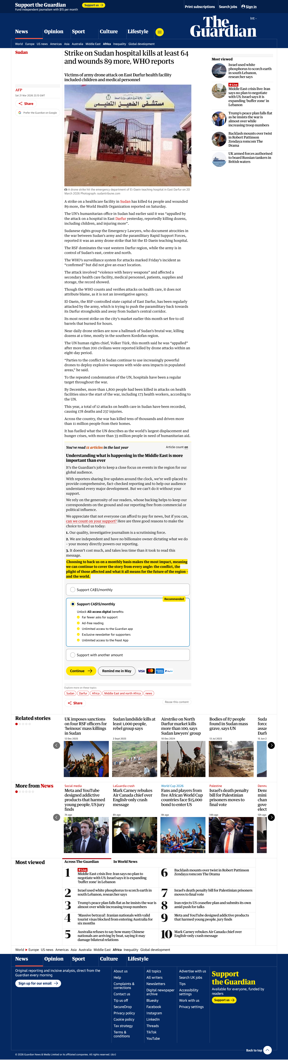
Update on the Issue
March 20, 2026
64 people killed and 89 wounded.
Healthcare providers and vulnerable populations harmed.
Peace is disrupted and rights to basic needs are impacted.
El Daein Teaching Hospital remains non-functional
https://www.theguardian.com/world/2026/mar/21/strike-on-sudan-hospital-kills-wounds-world-health-organization-reports

Slide 10

Applicable Course Concepts
1. War and Armed Conflict (Drones)
2. Power Holders
3. Determinants of health
4. Environmental Issues
5. Human rights and health (UN, WHO, IRC)
6. Population Health

Slide 11

Key Points of Discussion
1. Long term effects of War
2. Government corruption
3. Vulnerable populations as targets
4. Threats upon available healthcare
5. Global health crisis
https://www.shutterstock.com/image-vector/meet-team-people-talk-dialog-260nw-2244569207.jpg

Slide 12
Discussion Questions
The war has caused many people of Sudan to flee and become displaced to the neighbouring countries (such as Chad, Egypt, and South Sudan), how does this forced relocation influence the countries that receive the people?
As members of the healthcare system who reside in a different part of the world, are there ways to make a positive impact or changes in these war outcomes suffered by the people in Sudan?
War causes a disruption to the health qualities of people in war-torn countries. In Sudan’s context, what kind of potential outcomes can be identified as a result of these poor conditions?
Communities in Sudan are caught between two factions in a power struggle. What does it mean for ordinary citizens when the people who are supposed to protect them are the ones causing harm? How does this kind of power imbalance and helplessness shape health for vulnerable populations, and maintain trust in institutions?
Consider the infrastructure (80% health centres gone, schools destroyed), 19 million with food insecurity, and 13 million displaced with nowhere to return to. Consider a generation of children growing up only knowing war, famine, violence, and death. What are the long-term health implications physical, mental, and social for a generation shaped by this trauma? As future nurses, what does it mean to care for a population whose wounds will outlast the conflict by decades? https://www.youtube.com/watch?v=im_rmSMKflM

Slide 13
References
Agence France-Presse. (2026, March 21). Strike on Sudan hospital kills at least 64 and wounds 89 more, WHO reports. The Guardian. https://www.theguardian.com/world/2026/mar/21/strike-on-sudan-hospital-kills-wounds-world-health-organization-reports
Al Jazeera. (2026, March 12). Students among 17 dead in RSF drone attack in Sudan's White Nile State. https://www.aljazeera.com/news/2026/3/12/students-among-17-dead-in-rsf-drone-attack-in-sudans-white-nile-state
British Red Cross. (2026, March 12). Sudan: Humanitarian aid and support. https://www.redcross.org.uk/about-us/what-we-do/international/sudan
Council on Foreign Relations. (2025). Civil war in Sudan. Global Conflict Tracker. https://www.cfr.org/global-conflict-tracker/conflict/power-struggle-sudan
Doctors Without Borders Canada. (2025a, June 6). Sudan: MSF report reveals stark lack of protection and assistance in South Darfur. https://www.doctorswithoutborders.ca/sudan-msf-report-reveals-stark-lack-of-protection-and-assistance-in-south-darfur/
Doctors Without Borders Canada. (2025b, October 1). Crisis in Sudan. https://www.doctorswithoutborders.ca/crisis-in-sudan/
International Council of Nurses. (2025). Health care in conflict: The nursing perspective. https://www.icn.ch/sites/default/files/2025-02/PS_04-Health%20care%20in%20conflict%20the%20nursing%20perspective_2025_EN%20_Final.pdf
International Rescue Committee. (2024, April 12). Conflict in Sudan: Over 8 million people displaced. https://www.rescue.org/article/war-sudan-over-8-million-people-displaced
MacDonald, S. A., & Jakubec, S. L. (Eds.). (2022). Stanhope and Lancaster's community health nursing in Canada (4th ed.). Elsevier.
Office of the United Nations High Commissioner for Human Rights. (2026, March 13). Sudan: Türk appalled by surge in deadly drone attacks on civilians in Kordofan and White Nile. https://www.ohchr.org/en/press-releases/2026/03/sudan-turk-appalled-surge-deadly-drone-attacks-civilians-kordofan-and-white
Sassmannshausen, F. (2026, March 25). Devastating Sudan hospital attack disrupts medical care, deepens humanitarian crisis. Health Policy Watch. https://healthpolicy-watch.news/devastating-sudan-hospital-attack/
The Associated Press. (2026, March 11). At least 17 killed after drone strikes school in Sudan. CBC News. https://www.cbc.ca/news/world/sudan-white-nile-school-strike-rsf-blamed-9.7124191
Tomaszewska-Mortimer, D. (2026, March 24). Sudan: Hospital strike highlights surge in drone attacks on civilians. UN News. https://news.un.org/en/story/2026/03/1167189
UNICEF Sudan. (2024). Maternal health. https://www.unicef.org/sudan/topics/maternal-health
United Nations Department of Economic and Social Affairs, Population Division. (2024). World Population Prospects 2024 [Data set]. United Nations. https://population.un.org/wpp/
United Nations News. (2026a, January 10). Sudan war leaves millions hungry and displaced as health system nears collapse. https://news.un.org/en/story/2026/01/1166738
United Nations News. (2026b, March 13). World news in brief: Deadly drone attacks in Sudan, violence against women in the spotlight, more clashes in DR Congo. https://news.un.org/en/story/2026/03/1167125
United Nations News. (2025, December 23). UN warns Sudan war entering deadlier phase as fighting spreads in Kordofan. https://news.un.org/en/story/2025/12/1166655
United Nations Office for the Coordination of Humanitarian Affairs. (2024, April 15). Sudan: One year of conflict — Key facts and figures. https://www.unocha.org/publications/report/sudan/sudan-one-year-conflict-key-facts-and-figures-15-april-2024
World Health Organization. (2026a, January 9). Sudan: 1000 days of war deepen the world's worst health and humanitarian crisis. https://www.who.int/news/item/09-01-2026-sudan-1000-days-of-war-deepen-the-world-s-worst-health-and-humanitarian-crisis
World Health Organization. (2026b, February 25). Public health situation analysis — Sudan conflict and complex emergency. https://cdn.who.int/media/docs/default-source/documents/emergency-care/phsa-sudan-conflict-and-complex-emergency.pdf?sfvrsn=ffbbd08_1&download=true
World Health Organization. (2025, October 29). WHO condemns killings of patients and civilians amid escalating violence in El Fasher, Sudan. https://www.who.int/news/item/29-10-2025-who-condemns-killings-of-patients-and-civilians-amid-escalating-violence-in-el-fasher--sudan

